Slide 1
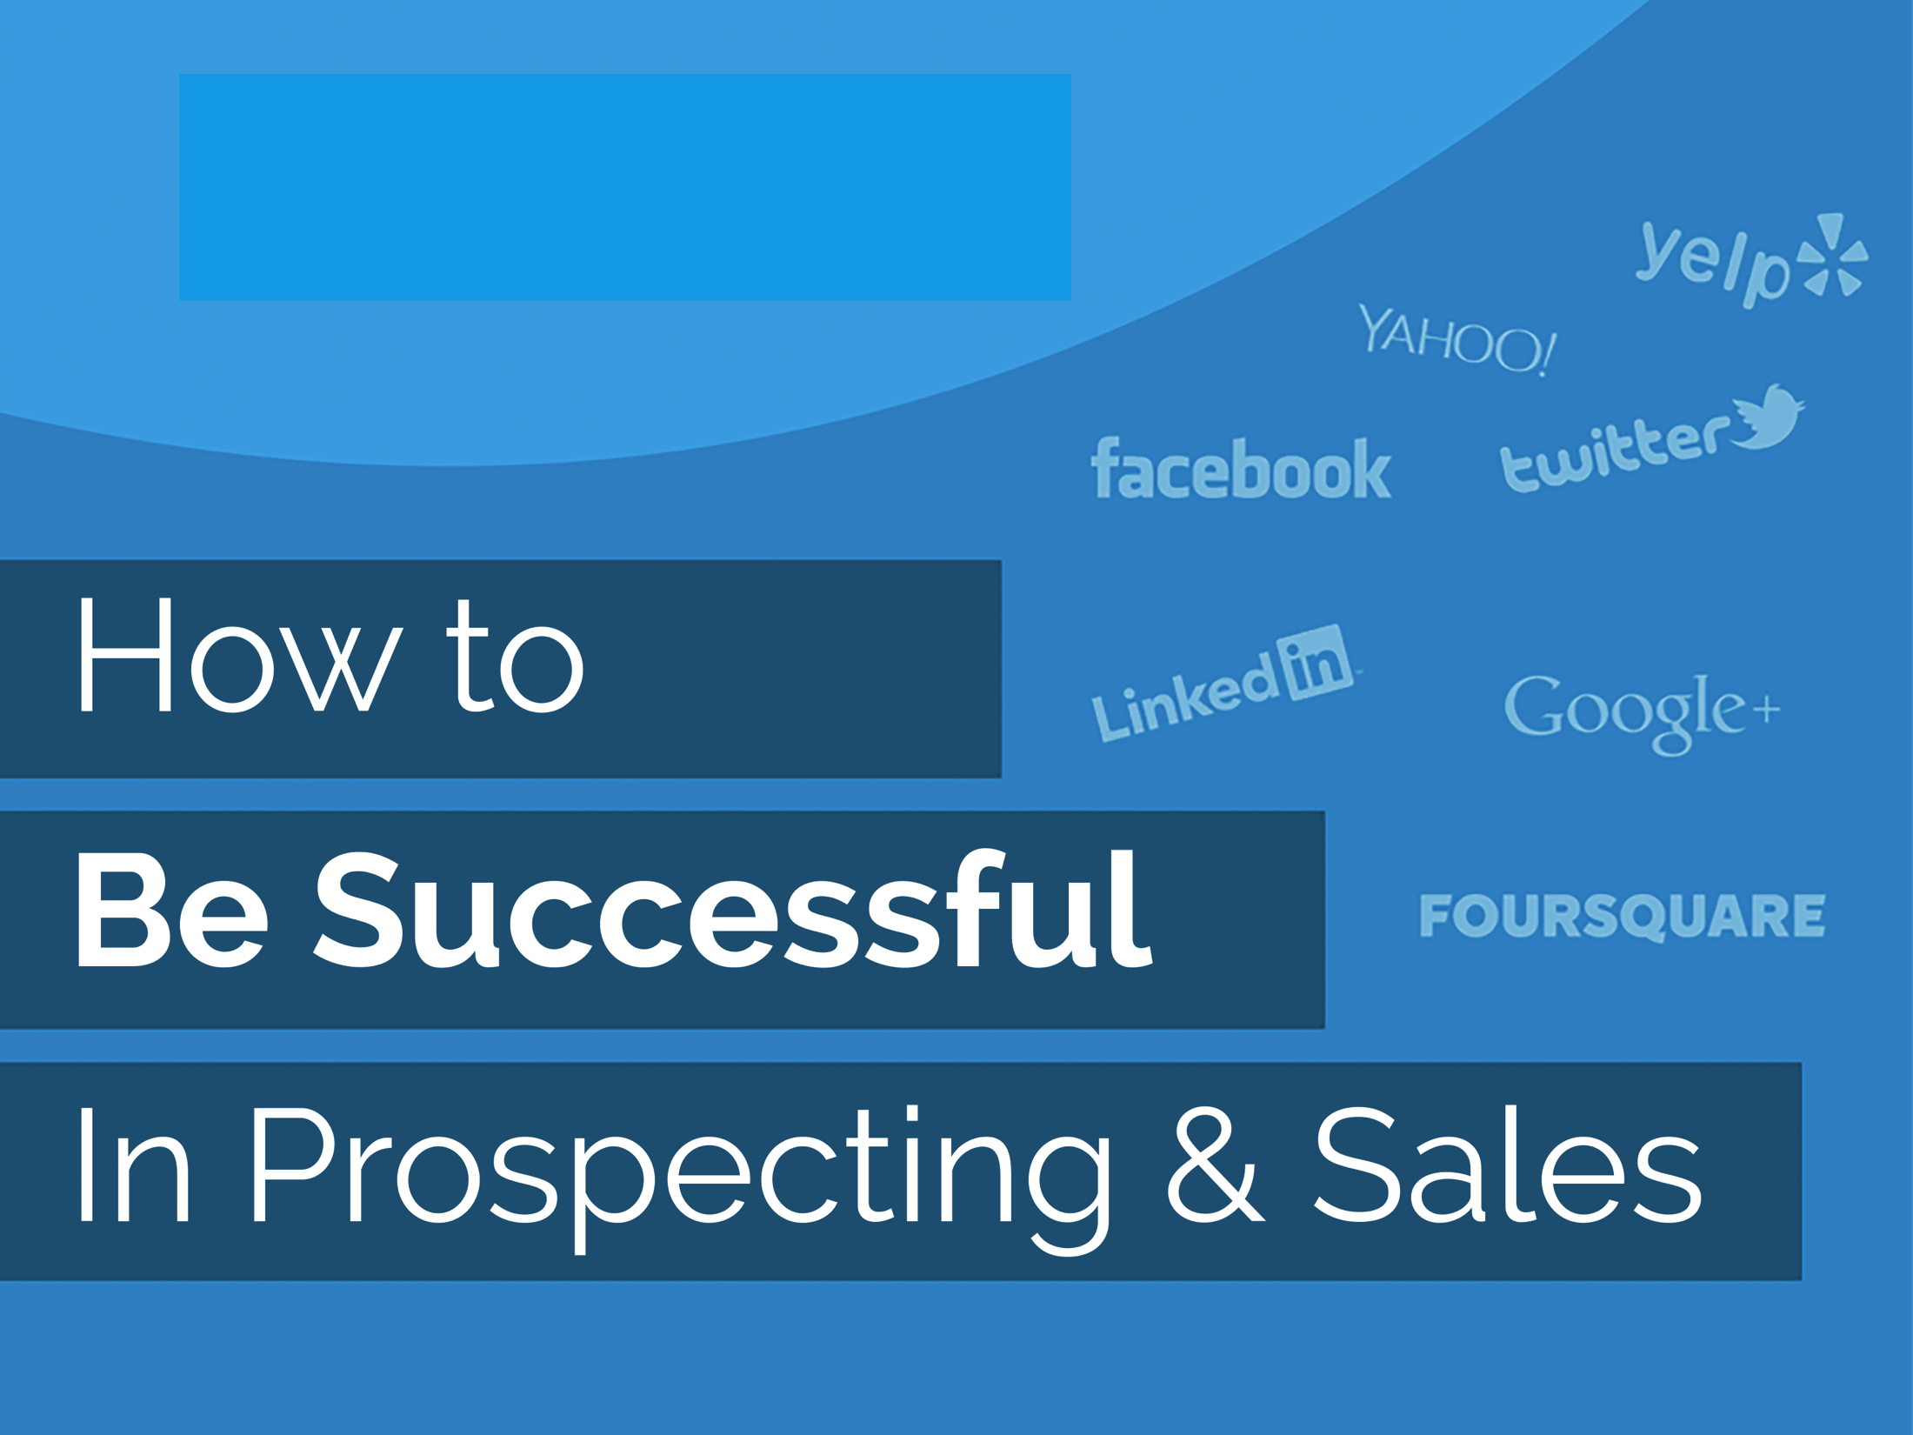
Your Logo Here

Slide 2
Your Logo Here
Understand the Sales Process
Leads
There are 3 types of people in the sales process:
Leads: One who becomes aware of your business or someone you decide to pursue for a sale, even if they don’t know about you yet.
Prospects: Someone who has had some kind of contact with your business and are still interested. All prospects are leads, but not all leads are prospects.
Customers: People who have made a purchase!
Prospects
Customers

Slide 3
Your Logo Here
Awareness
Build a Sales Funnel
Education
Turn Leads into Prospects…
…and Prospects into Customers!
Create awareness
Educate your prospects
Allow prospects to evaluate product/service
Engage with prospects and close the deal
Customers makes the purchase!
Evaluation
Engagement
Purchase

Slide 4
Your Logo Here
Awareness
Education
Evaluation
Engagement
Step One: Awareness
Purchase
The first step of any sales funnel is to raise awareness of your existence to potential customers.
You can raise awareness in several ways including but not limited to:
Social Media Marketing
Email Marketing
Cold Calling
Attending Events/Networking
Advertising
Word of Mouth
Big picture: Be where your ideal customers are and you will get noticed!

Slide 5
Your Logo Here
Awareness
Education
Evaluation
Engagement
Step Two: Education
Purchase
The second step of a successful sales funnel is to educate your prospects.
Teach your prospects why they need your service, how it works, and what sets you apart.
Find common connections between you and your potential customer and treat them as you would a friend instead of aggressively pushing the sale.
Show your prospects examples of how the platform works.
Stress the power, appeal, and ease-of-use of the built-in tools such as the content banners, deals and sweepstakes, social ordering, and monitoring.
Give real examples of how you and the platform can benefit their business.
Big Picture: Prepare, explain, demonstrate, and build trust.

Slide 6
Your Logo Here
Awareness
Education
Evaluation
Engagement
Step Three: Evaluation
Purchase
Step three in a successful sales funnel is allowing the prospect to evaluate what you’re offering.
Allow your prospects some time to themselves to consider your service and arm them with:
An open invitation to contact you with any additional questions through whatever medium they prefer.
Compelling physical and/or digital materials for them to review as consider their options.
The comfort that you walk-the-walk as a social media expert by regularly updating your social channels with the most up-to-date information and examples of the platform.
Endorsements and praise of current customers once you’ve built up your business.
Big Picture: Give prospects space and remember that they may check your digital activity at any time.

Slide 7
Your Logo Here
Awareness
Education
Evaluation
Engagement
Step Four: Engagement
Purchase
Step four in a successful sales funnel is to simply ask for the sale.
Your prospect has had time to evaluate, now ask for the sale and sweeten the deal if need be:
Many prospects get stuck in this part of the funnel – nudge them closer to making a sale without being too pushy.
Don’t give up! You may need to contact a prospect several times before making a sale.
If your prospect needs an added incentive to make the purchase, make a limited time offer:
Waive the Social Set-up and Optimization fee or offer a free trial period.
A complimentary upgrade to next package level
Big Picture: Ask nicely, sweeten the deal, and make the sale.

Slide 8
Your Logo Here
Awareness
Education
Evaluation
Engagement
Step Five: Purchase
Purchase
Congratulations! You’ve made the sale. Celebrate and leverage your new customer.
Don’t stop there, Make your new customer a loyal fan to help you to create more awareness by:
Nurturing your new customer and making sure their expectations are exceeded.
Asking that they endorse/review you on their preferred social channels.
Asking to use a quote about their positive experience with you for your marketing efforts to new leads and prospects.
Asking that they refer new businesses to you.
Sharing positive feedback on your social channels.
Big Picture: Word of mouth is integral to finding new leads for the awareness part of the sales funnel.

Slide 9
Your Logo Here
Awareness
Education
Evaluation
Engagement
Recap: Sales Funnel Overview
Purchase
In review, here’s the who, what, when, why, and how of sales funnels:
Who: You and all businesses should have a sales funnel in place to turn leads into customers.
What: A sales funnel allows a person to become aware of your company, learn about it, evaluate your offerings and decide whether or not to buy.
When: You can start raising awareness to leads immediately by making yourself visible where your ideal customers hang out in the digital and physical worlds.
Why: Sales funnels give you an organized way to generate new revenue for your business, track your return on investment, and place greater value on customer retention practices.
How: Review this presentation, plan your strategy, and execute! Still have questions? Contact us!

Slide 10
Your Logo Here
Questions?
Contact:
Your Email
Visit:
Your Website
Connect:
Facebook | Twitter | LinkedIn | Google+

