Slide 1
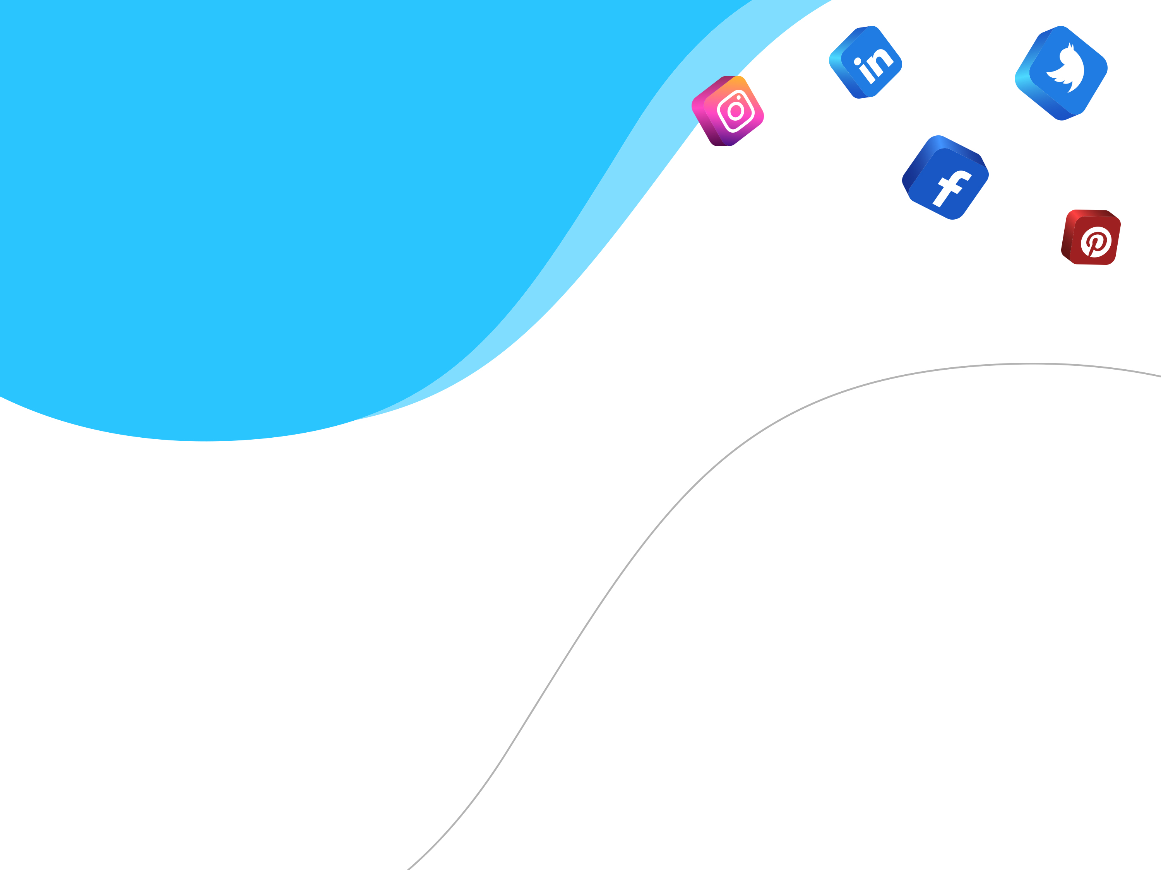
Your Logo Here
LinkedIn
Best Practices
For You & Your Business

Slide 2
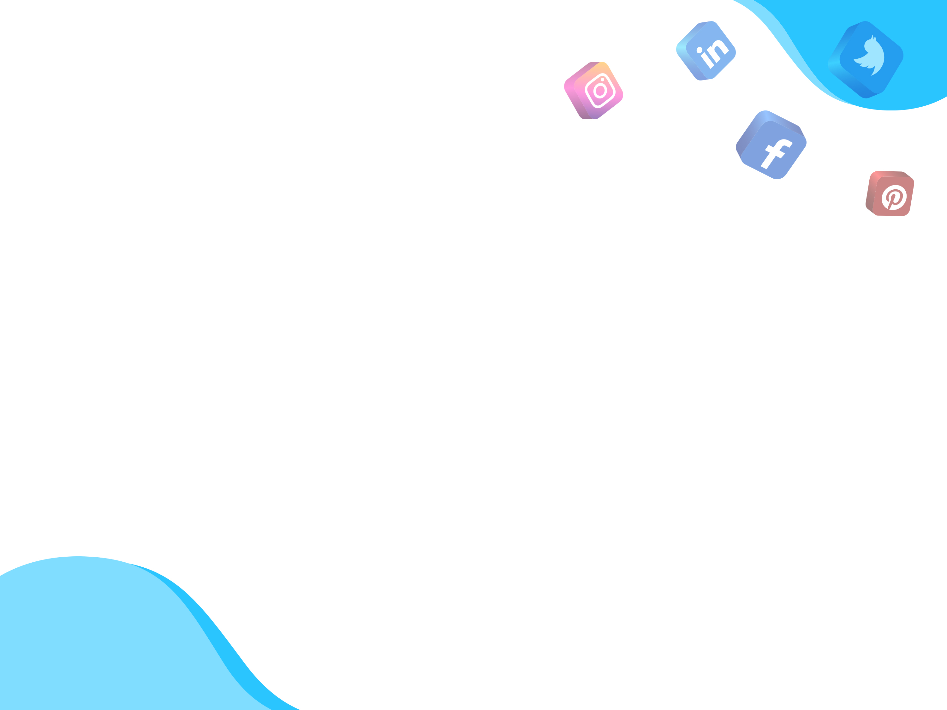
Your Logo Here
Leads
Prospects
Customers
Set Goals for Your Company Page
What do you want to achieve?
  Generate leads
  Raise awareness of your brand/business
  Attract Followers
  Engage customers
  Recruit new talent to join your team
$$$

Slide 3
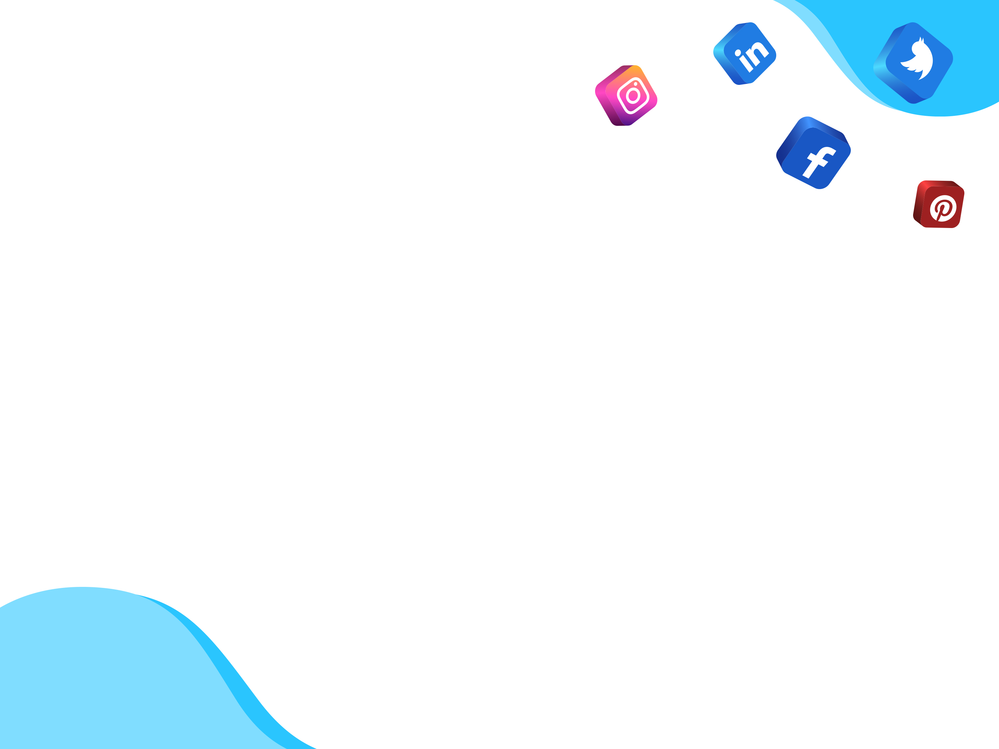
Your Logo Here
Optimize Your Page
Use appropriate imagery
  Use your company logo as your profile image
  Display a professional cover photo that tells your business’ story
Use rich, descriptive language with keyword optimized at the beginning of description
  Google search previews up to the first 150 characters of your company page text
  Educate your visitors on who you are and what you do
  Explain why your company and product are valuable and use language your target audience understands
Share relevant content regularly
  The more frequently you share content your followers engage with, the higher you page will appear in search results
  Increase your chances of engagement by stopping users in their tracks with eye-catching imagery

Slide 4
Your Logo Here
Get Insights with Company Page Analytics
Gain insight into your page performance, see how engaging your posts are, identify trends, and understand more about your follower demographics and sources.
See individual post activity, demographics of your follows, where they come from, how you compare to your competitors, and more.

Slide 5
Your Logo Here
Leverage LinkedIn Groups
A great way to find blocks of leads is to search for, join, and engage with LinkedIn groups
Look for groups with these three key features:
  Highly relevant: The group matches what you are seeking in a target audience
  Active: LinkedIn ranks groups according to their activity level, so all you need to do is pay attention to how active they are in the search results – select groups that are “very active”
  Medium size: Don’t get lost in huge groups where no one will notice you and don’t join a group that has too few people to matter. LinkedIn allows you to be a member of 50 groups, so choose carefully.
Seek to join conversations, engage with users, and answer questions users pose.

Slide 6
Your Logo Here
Promote Your Company Page
Build your community of followers and drive traffic to your Company Page
Link to your company page:
  Links to your company page is essential to help boost your ranking in search
  Link to your LinkedIn company page from your website
  Link to your LinkedIn company page from your and your employees’ personal LinkedIn pages
  Link to your LinkedIn company page from other social networks
  Link to your LinkedIn company page in your email signature
LinkedIn generates social media’s highest lead conversion rate!
  In a study of more than 5,000 businesses, HubSpot found that traffic from LinkedIn generated the highest visitor-to-lead conversion rate at 2.74% - 277% higher than Twitter (.69%) and Facebook (.77%)

Slide 7
Your Logo Here
Recap
Set Goals - What do you hope to achieve?
Optimize Your Page – Make sure you and your page gets found.
Get Insights – Find out what works, doesn’t work, and who your prospects are.
Leverage Groups – Find the right groups and engage with its users.
Promote Your Page – Drive more traffic to your page.

Slide 8
Your Logo Here
Questions?
Contact:
YourEmail@Email.com
Visit:
www.YourWebsite.com
Connect:
Facebook | Twitter | LinkedIn

