Slide 1
Your Logo Here
How to Make Money
Turn-Key Social Media
& Online Reputation Business
www.YourBusiness.com

Slide 2
Your Logo Here
Two Ways To Make Money
1
Resell Social Media Software
2
Manage Business’s Social Media
Or A Combination Of Both!
www.YourBusiness.com

Slide 3
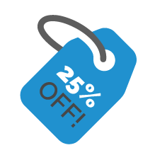
Your Logo Here
Social Deals & Sweepstakes
Customized contests & deals
Contest & deal landing pages
Grow email lists
Resell Social Media Platform
Social Media
Post Scheduling
One click content feeds
Page & post analytics
Social Ordering
Sell products online
Pick-up & delivery options
Content Banners
Brands business after user has clicked off social page
Advertise or grow email lists
Reputation Monitoring
Monitor Online Reviews
Real-time review alerts

Slide 4
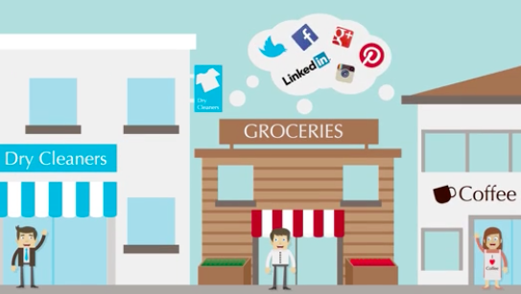
Your Logo Here
Manage Business’s Social Media
Quick Look:
Easy to use software
White label sales and marketing materials
Training advice & tutorials
Ability to undercut marketing companies by hundreds of dollars
Our expertise
www.YourBusiness.com

Slide 5
Your Logo Here
Your Business, Our Software
✔
100% your business
Set your own plans and pricing
Keep 100% of your sales
White labeled website on your domain
No experience needed!
✔
✔
✔
✔
www.YourBusiness.com

Slide 6
Your Logo Here
What You Get
Business-in-a-Box
✔
Branded Website (your domain)
Social Software
Client Portals
Hosting & Updates
On-Going Training
Marketing & Sales Materials
Software Updates
Our Expertise
✔
✔
✔
✔
✔
✔
✔

Slide 7
Your Logo Here
Get Started Today!
For a limited time, get started for as low as $XXX
YourEmail@Email.com
Your Phone #
Don’t wait, this offer won’t last!
www.YourBusiness.com

