Slide 1
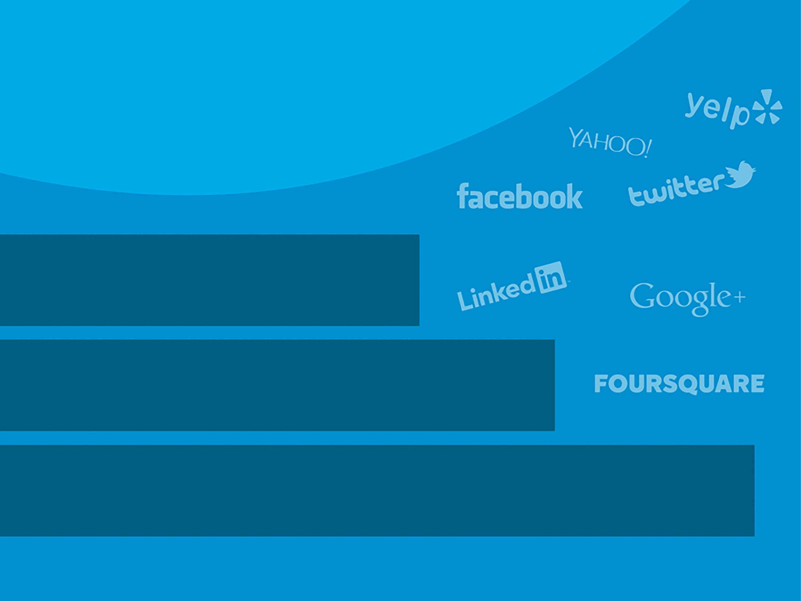
Your Logo Here
Creating
and Connecting
Facebook, Twitter, & Linkedin

Slide 2
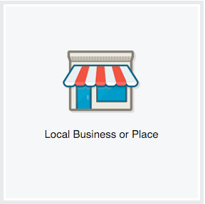
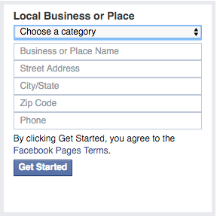
Your Logo Here
Creating a Facebook Page
To Create a Page:
Go to facebook.com/pages/create
Click to choose a Page category
Select a more specific category from the dropdown menu
and fill out the required information
Click Get Started and follow the on-screen instructions

Slide 3
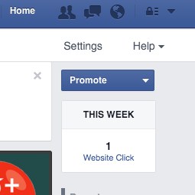
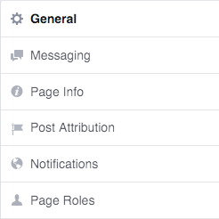
Your Logo Here
Securing Facebook Page Admin Rights
To Secure Facebook Page Admin Credentials:
Have page owner visit their business page
Click “Settings” at the top right of the page
Click “Page Roles” in the left column
If you are a Facebook friend, begin typing your name and
select you from list that appears OR enter the email
address associated with your Facebook account
Click “Save” and enter password to confirm.

Slide 4
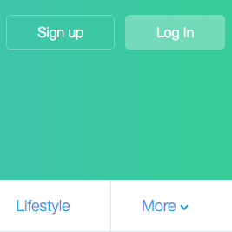
Your Logo Here
Creating a Twitter Account
To Create an Account:
Go to: http://www.twitter.com and find the sign up box
Enter you full name, phone number, and a password
Click Sign up for Twitter
Verify your phone number via SMS text message
Once you’ve clicked Sign up for Twitter, select a username
(Usernames are unique identifiers on Twitter)
Double-check your name, phone number, password, and username
Click Create my account

Slide 5
Your Logo Here
7 Steps to get your Twitter Account Set Up the right way
Choose a profile name. This is how you’ll be known on Twitter (your “@name”)
Add a photo of you or your logo
Complete your bio
Add your website address
Follow some people and related business accounts
Get tweeting
Check your mentions regularly

Slide 6
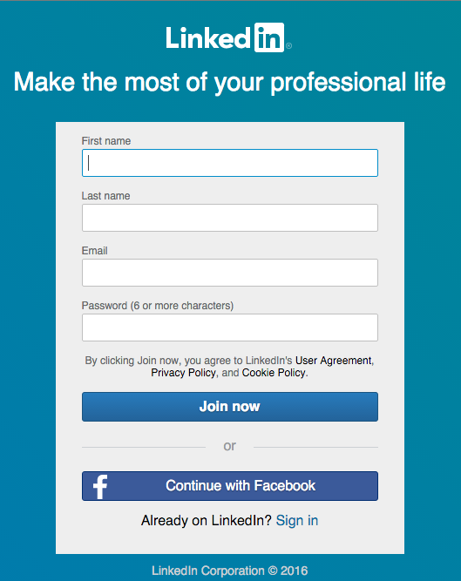
Your Logo Here
Opening a LinkedIn Account
To Create a LinkedIn Account:
Go to: https://www.linkedin.com/reg/join
Type your first name, last name, email address and
password you’ll use
Click “Join now”
Complete any additional steps as prompted

Slide 7
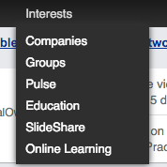
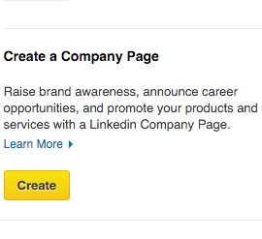
Your Logo Here
Creating a LinkedIn Company Page
To add a Company Page:
Move your cursor over “Interests” at the top of your
homepage and select “Companies”
Click “Create” in the Create a Company Page box
on the right
Enter your company’s official name and your
work email address
Click “Continue” and enter your company information

Slide 8
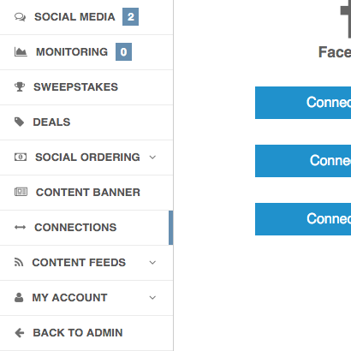
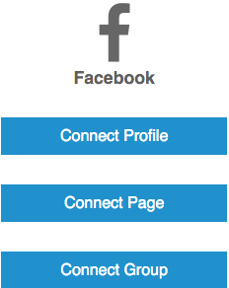
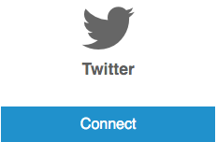
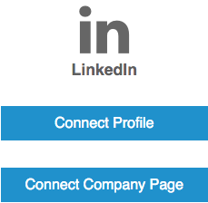
Your Logo Here
Connecting Accounts To Your Platform
To connect social media accounts to your platform:
Click “Connections” tab on left side menu
Click “Connect” button under the accounts you wish to connect
Select appropriate connection from list and/or follow prompts

