Slide 1
Your Logo Here
The Future of Effective
Social Media Is Here!
ATTRACT – ENGAGE – PROMOTE – RETAIN YOUR CUSTOMERS
Presenter
YOUR NAME HERE
www.YourWebsite.com

Slide 2
Your Logo Here
Leads
Prospects
Customers
What We’ll Cover
Problem Businesses Face
|
Options to Improve Social Media Presence
|
Our Proprietary Software Platform
|
Cost & Getting Started
$$$

Slide 3
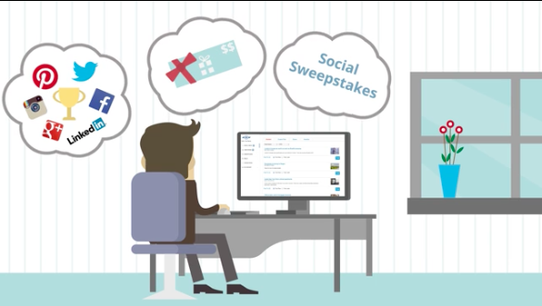
Your Logo Here
Problems Businesses Face
No Social Presence = Competitive Disadvantage
No Time To Learn Social Media To Effectively Engage Customers
Limited Time Spent Promoting Business Using Social Media
Current Social Media Presence Does Not Drive Sales
Little To No Understanding Of What Customers Are Saying Online (Online Reputation)

Slide 4
Your Logo Here
Social Media At A Glance
World Population = 7.210 BILLION
Active Social Media Accounts
2.078 BILLION
Avg. American time spent on Social Media
37 Minutes Per Day
8 out of 10 Small & Medium Sized Businesses use social media for their business to drive growth
46% of web users look towards social media when making a purchase
70% of B2C marketers have acquired customers through Facebook
67% of Twitter users are far more likely to buy from brands they follow
- Over ONE BILLION people actively user Facebook every month
- Over 300 MILLION active Twitter users per month
- LinkedIn boasts the highest visitor-to-lead conversion rate at 2.74% - 277% higher than Twitter & Facebook
- 90% of Yelp users say that reviews affect their purchases

Slide 5
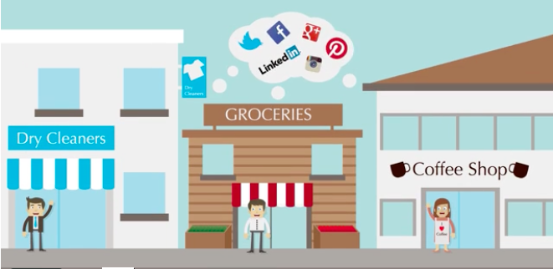
Your Logo Here
Options to Improve Social Presence
Current Promotional Prices
for Options 2 & 3
Social Media Software
Regularly $xxx per month
Now $xxx per month
SAVE $XXX PER YEAR!
Turn Key Solution
with Software and Services
Regularly $xxx per month
Now: $xxx per month
SAVE $XXX PER YEAR!
1. Hire a Marketing Company to Manage for You
- Can be quite costly, $500 - $2,500 per month depending on services provided
2. Invest in Social Media Marketing Software
- Automate regular tasks and schedule social posts
- Promote your product / service on social media
- Monitor your online reputation
- Create a new sales channel with Social Commerce
- Self-manage your social media strategy using the platform
3. Invest in a Turn Key Solution Where I Manage For You
- Software to help your business grow
- Services to create social interaction & increase customer engagement
- Consulting to ensure your objectives are met

Slide 6
Your Logo Here
ATTENTION!
ONLY USE THIS PAGE IF YOU HAVE SUBSCRIBED TO THE ADVANCED PROSPECTING APPLICATION.
OTHERWISE REMOVE AS IT IS NOT APPLICABLE
The Software Platform
Competitive Analysis
Ask about our competitive reporting utility and see the differences between you and your local competition in Facebook:
Likes
Check-ins
Posts over 3, 6, & 12 months
Post engagements
See what they are posting, when, and how engaging they are!
vs
Your
Business
Your
Competition

Slide 7
Your Logo Here
The Software Platform
Ability to schedule and post industry-specific articles with RSS connection capabilities
Schedule as many posts, as far into the future, as many times as you desire
Reinforce your brand and build your email list with Content Banner posting technology
Gain insight into social engagement with Social Analytics
Social Media
Marketing
View all of your reviews on sites like yelp all in one place
Receive email alerts each time a new review is written about your business
Combat negative reviews and improve your online reputation
Reputation
Monitoring

Slide 8
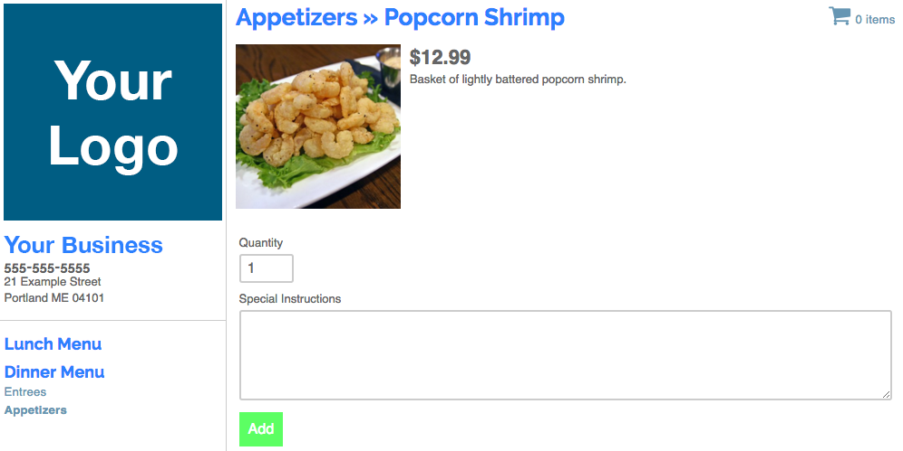
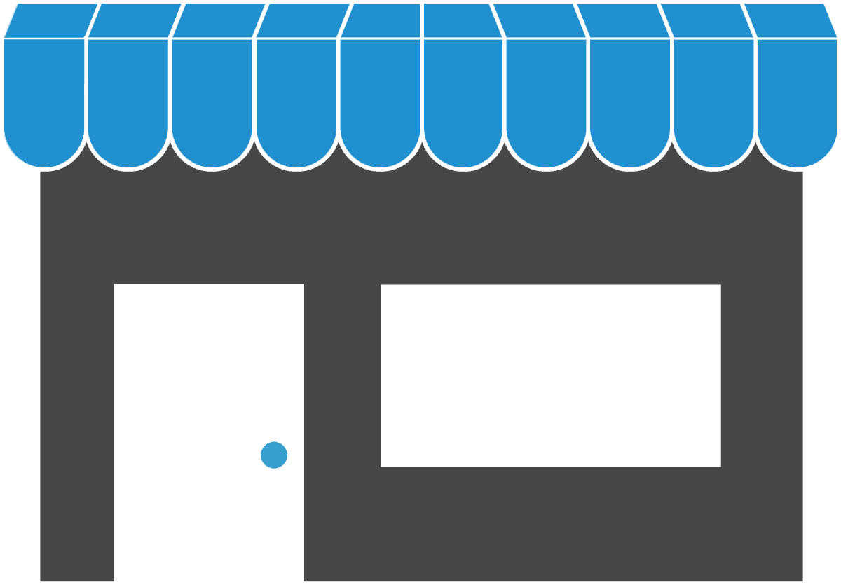
Your Logo Here
The Software Platform
Social Shopping Cart
Open a new sales channel by selling your products online
Connect Facebook to your own digital storefront
Pick-up and delivery options
Customizable storefront page
Export sales history

Slide 9
Your Logo Here
Get Started Today!
Options:
1
Turn Key Solution
with Software and Services
Regularly $xxx per month
Now: $xxx per month
SAVE $XXX PER YEAR!
Social Media Software
Regularly $xxx per month
Now $xxx per month
SAVE $XXX PER YEAR!
2
Questions?
Call: Your phone number Email: youremail@email.com
- or -
www.YourWebsite.com

